Slide 1

TOPIC NAME : ONLINE QUIZ SYSTEM COURSE CODE : CSE – 0318 COURSE NAME : SOFTWARE ENGINEERING LAB STATE UNIVERSITY OF BANGLADESH
SUBMITTED BY,
FARHANA RAHMAN ,
ID : UG02-47-18-031
DEPARTMENT OF CSE
SUBMITTED TO,
KHAN MD. HASIB
LECTURER , DEPARTMENT OF CSE

Slide 2
OUTLINES
INTRODUCTION & DEFINATION
REQUIREMENTS
ADVANTAGES
DISADVANTAGES
STARTING PAGE
REGISTRATION PAGE
PROJECT SUMMARY
CONCLUSION

Slide 3
INTRODUCTION & DEFINATION
Online quizzes are quizzes that are published on the internet and are generally for entertainment or learning purposes.
Quizzes can be also used as a brief assessment in education and similar fields to measure growth in—
Knowledge
Abilities
Skills

Slide 4
REQUIREMENTS
FRONT-END : HTML, CSS, JAVASCRIPT
BACK-END : PHP, MYSQL DATABASE
FRAME WORK : BOOTSTRAP
SOFTWARE : VS-CODE, XAMPP
WEB BROWSER : GOOGLE CROME

Slide 5
ADVANTAGES
LARGE NUMBER OF PARTICIPANTS
ENGAGE OUR AUDIENCE
GAIN INSIGHT IN AUDIENCE
NO INSTRUCTOR NEEDED

Slide 6
DISADVANTAGES
CHALANGES IN TECHNOLOGY ADOPTION
INFRASTRUCTURAL BARRIERS
SUSCEPTIBLE TO CHEATING

Slide 7

STARTING PAGE

Slide 8
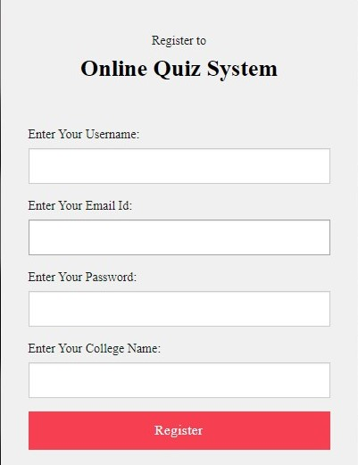
REGISTRATION PAGE

Slide 9
PROJECT SUMMARY
LOGIN & REGISTER PAGE
USER PAGE
ONLINE QUIZ PAGE
SUBMIT BUTTON
RESULT PAGE
ADMIN PAGE
LOGOUT OPTION

Slide 10


Slide 11


